Slide 1
CONVOLUTIONAL NEURAL
NETWORKS
What is CNN?
-CNN also known as Convolutional Neural Network is a special kind of Neural Networks for processing data that has a grid -like-structure, these may include 1D time series data or 2D images.
-CNN is a very important concept in Deep Learning that was developed specially to overcome the drawbacks of the ANN model.
-The concept of CNN was inspired by the working of our visual cortex present in our brain, which takes input from the retina and enables us to process various information like color, orientation, shape, edges etc.

Slide 2
Why use CNN over ANN?
-It’s not like we cannot use ANN’s for classifying grid-like-structures like an image , we might as well classify the image accurately.
-For example, let's say we have an image of size 40*40 pixels and to process the image take an ANN model of 100 units.
-Now, we pass the pixel values of the image as a 1D array , since our image is of 40*40 pixels we’ll need to pass 40 such arrays which will acts as inputs for our model.
-Each pixel value in a cell is connected to each and every neuron of the first hidden layer of our model. So, this means we will get a total of 40*40*100 i.e 1,60,000 parameters.
-All these 1,60,000 parameters or weights in the first layer itself are trained and computed, this results in massive increase in the computational cost of our model.
-This is one of the major drawbacks of using an ANN model.

Slide 3
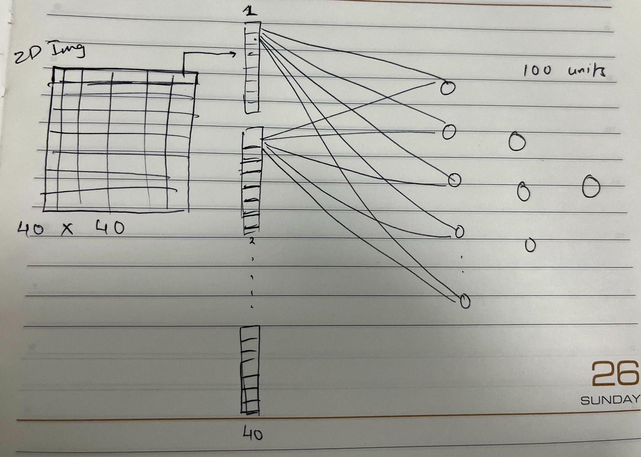
-The complexity and computational cost of the ANN model will increase even further with increase in the image size.

Slide 4
- Another drawback of using ANN model is Overfitting.
-If we have 1,60,000 weighted connections our aim will be to capture every minute detail and patterns within in our image and weights will be trained according to it , this may result in overfitting.
- This tells us that the model may perform very well on training data but will perform poorly on the unseen testing dataset.
- One more drawback of using ANN is that the important features may be lost when transforming the pixel values of 2D image to 1D array.

Slide 5
Layers in CNN
CNN involves three basic layers that plays a vital role in successful implementation of the CNN model.
1. Convolutional Layer:
-This is most primary layer to identify that the neural network used is CNN.
-This layer involves the use of filters or kernel that overlap with our raw image to identify the important features within our image such as vertical or horizontal edges, shapes, colors etc.
-Syntax : Conv(No. of filters,(filter_size, input_size()))
2.Pooling:
-Pooling is a simple technique in CNN which is used to reduce the overall size of the image.
-Syntax: Pooling_layer(filter_size)

Slide 6
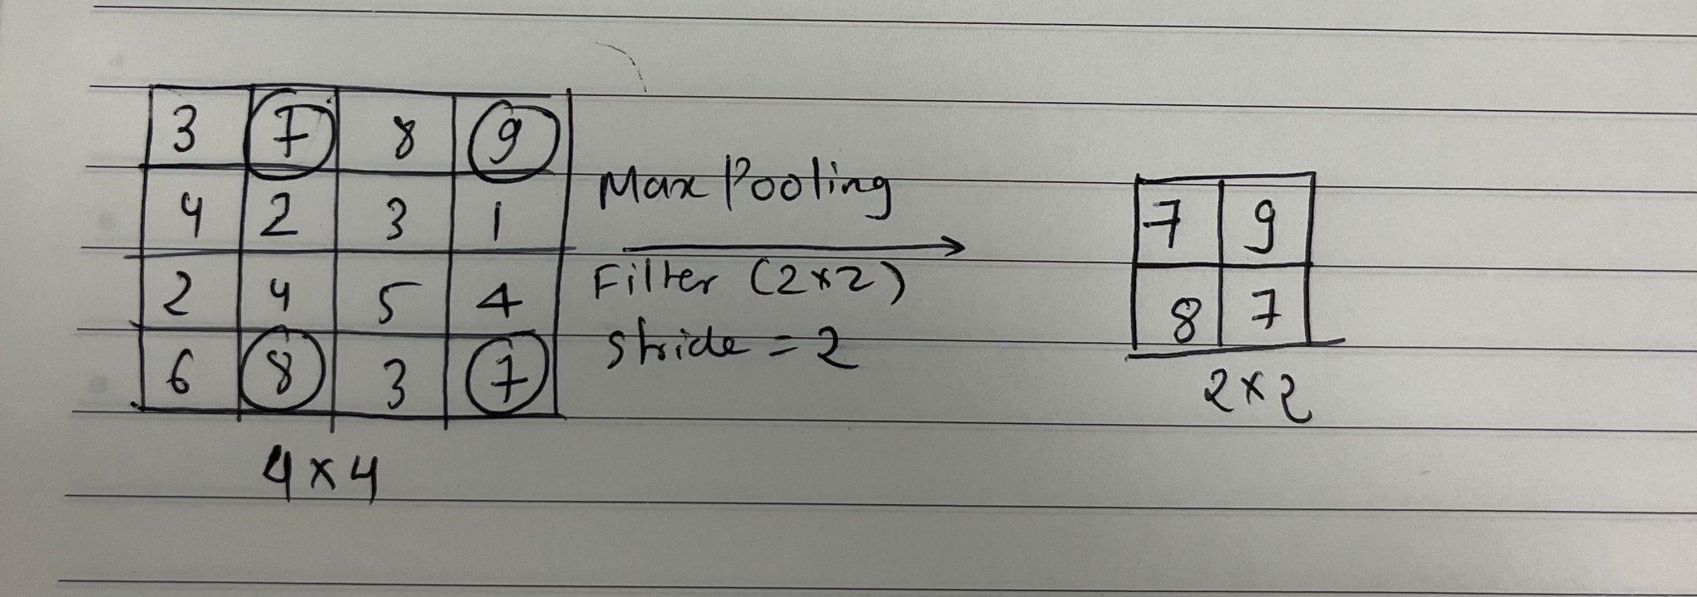
Pooling Layers in CNN.
I. MaxPooling:
-MaxPooling layer selects the maximum pixel value from the region of the feature map covered by the filter.
-MaxPooling not only reduces the size of the image but also preserves the important features obtained in the Convolutional layer.

Slide 7
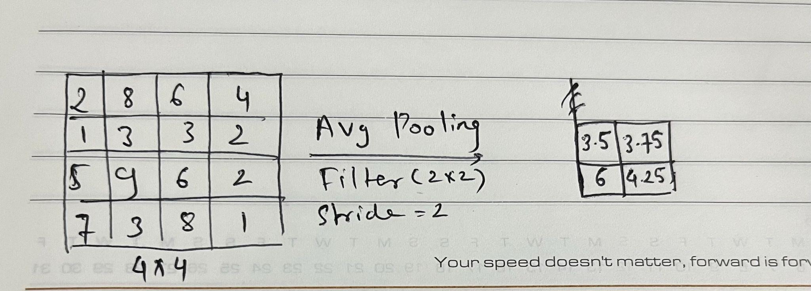
II. AveragePooling:
-AveragePooling layer calculates the average of all the pixel value from the region of the feature map covered by the filter.
-While max pooling gives the most prominent feature in a particular patch of the feature map, average pooling gives the average of features present in a patch.

Slide 8
3. FC or Fully Connected layer:
-The fully connected layer is also known as a Dense layer. It is often considered to be last layer in a CNN model.
-In this layer each neuron in the current layer is connected to every neuron present in the previous as well as the proceeding layers.
-This means that each neuron receives input from all the neurons from the previous layer and will also serve as input to the upcoming layers.
-In order to pass inputs to the fully connected layer we need to transform the pixel values of 2D image into a 1D array.
-This can be done using the Flatten layer, which helps in reshaping the 2D or 3D pixels of the image to 1D array.

Slide 9
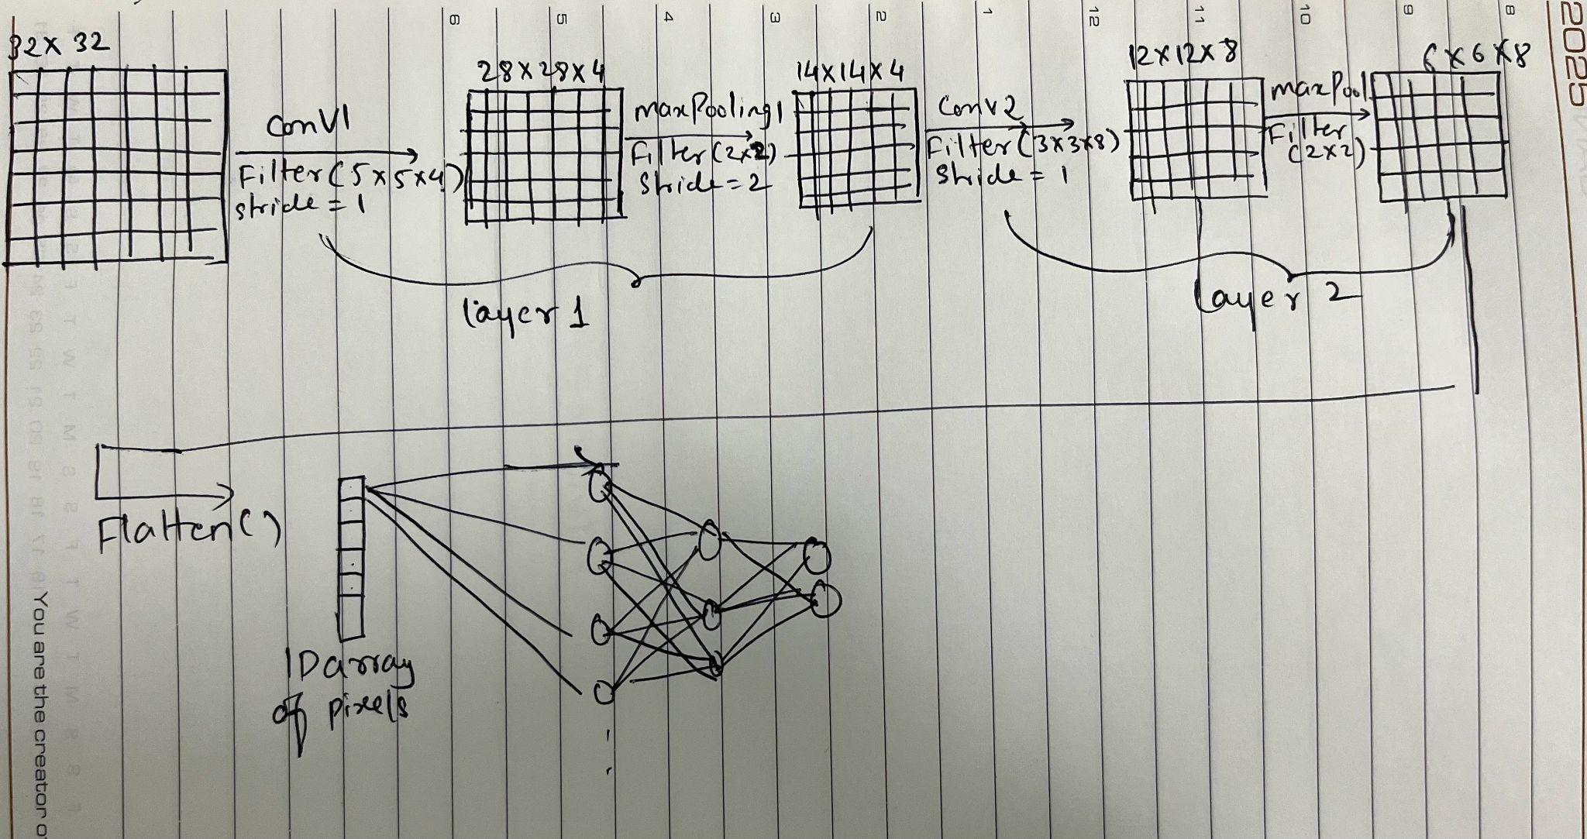
Architecture of CNN

Slide 10
Working of CNN
-Let’s say we have an image of size 32X32. We perform the convolution operation on the image using filter of size 5X5X4 with stride(1).Here, 4 denotes the number of filters.
-After Convolution operation we will get an image of size 28X28X4, this size can be determined using n-f+1 where,
n= input size
f=filter size
-(n-f+1) is nothing but an operation used to calculate the output size. So, applying the above expression we get,
n-f+1 = 32-5+1 = 28 , which will be our output size after applying Convolutional layer.
- Since we applied 4 filters on our image we will get 4 images each highlighting different important features.

Slide 11
-Now we’ll apply the pooling layer on the feature map obtained after the convolution operation. Pooling method used here is MaxPooling with 2X2 filter and stride (2).
-After applying MaxPooling we’ll obtain an image of size 14X14X4, this size is determined using the following expression,
new size = n-f/2 +1, which will give,
n-f/2+1 = 28-2/2+1 =14.
-Now this completes the first layer of our CNN model.
-Similarly, we apply 2nd Conv layer with filter of 3X3X4 and stride (1) on the previously obtained image and after this process we get a new image or feature map of size ,
n-f+1 = 14-3+1=12, which is 12*12*4.
-Similarly, we apply 2nd pooling layer with 2X2 filter and stride=2 on the feature map obtained after applying the 2nd conv operation , we get an image of size 6X6X4 by using, n-f/2+1= 12-2/2+1=6.
-Now we cannot pass the 2D image as input to the Fully Connected layer , we would need to transform the pixels of 2D image to 1D array, so that we can establish connections between each pixel value and each neuron of the fully connected layers.
-This transformation can be done using flatten layer , so now our final 6X6X4 image will be reshaped as a 1D array of pixels,so in total we will have 6*6*4 = 144 units

Slide 12
-Then these 144 units will considered as inputs for the first layer , where each neuron or unit is connected to each and every neuron in the layer

